Slide 1
Name(TBA)
Lvl 4/5 Group 8: Bailey Keeble, Ethan Ward, Callum Walsh and Tom WENman.

Slide 2

Logline
Help banish diseases from infecting a body or nullify the medicines effects by overpowering them, by launching projectiles at each sides minions.

Slide 3
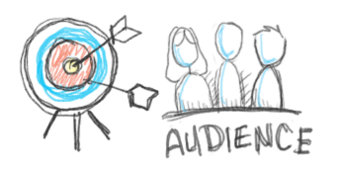
Target Audience
Core audience
Age’s between 8-12
Male and female.
Competitive gamers.
Sub audience
Age’s between 13-18
Male and female.
Casual gamers.

Slide 4





Markets & Platforms.
Platforms
Home PCs
Supporting platforms being Mac and Windows
Smartphones
Supporting platform being Apple smartphones and Android Smartphones.
Markets
PC markets
Supporting markets being ith.oi, Humble bundle and desura
Smartphone markets
Supporting markets being, Apple’s AppStore and Google’s Play store.

Slide 5
What does the player do?
Players will fire projectiles towards the enemy lines.
The launcher is effected by how much the mouse is held down and dragged.
Different types of projectiles can be used to allow different scenarios each play.
The goal is to knock the enemy characters into the death zone before they knock yours into it

Slide 6
First mechanic: Shooting/Launch
Shows the player the degrees/angle of where the player will shoot
Only shows the player.
Camera follows the arrow
Takes time to master as remembering where to shoot can be a challenge.

Slide 7
Second mechanic: Collision
Characters/ objects will react to another object colliding with it.
Destroys objects i.e. certain assets
Pushes them with force depending on what was launched.
Projectiles on collision will bounce of environmental walls, allowing trick shots to be achieved

Slide 8
Third mechanic Variants of projectiles
Some projectiles will have different effects during gameplay
Planned projectiles to be added;
One hit projectiles. (Explodes once it hits any collider, deals massive knockback).
Cluster projectiles. (Can hit multiple targets but deals little knockback)

Slide 9
Prototype

Slide 10

The player experience
We want the both players to experience
A sense of hard fun
Fiero, strategy and obstacles
A sense of people fun
Amusement and player interaction

Slide 11
Plans for the future

Slide 12
Questions?

